Slide 1
Lecture 4 Dynamic Programming, Backtracking and Branch-and-Bound

Slide 2
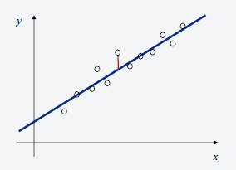


Segmented Least Squares
Least squares. Foundational problem in statistics.
Given n points in the plane: (x1, y1), (x2, y2) , …, (xn, yn).
Find a line y = ax + b that minimizes the sum of the squared error:
Solution. Calculus ⇒ min error is achieved when

Slide 3
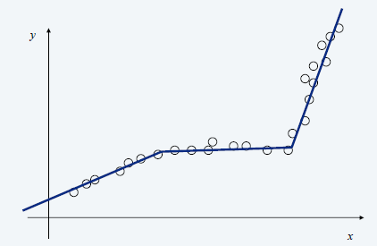
Segmented Least Squares
Segmented least squares: Points lie roughly on a sequence of several line segments.
Given n points in the plane: (x₁, y₁), (x₂, y₂) , …, (x_{n}, y_{n}) with x₁ < x₂ < ... < x_{n}, find a sequence of lines that minimizes f(x).

Slide 4
Segmented Least Squares
Given n points in the plane: (x₁, y₁), (x₂, y₂) , …, (x_{n}, y_{n}) with x₁ < x₂ < ... < x_{n}, and a constant c > 0, find a sequence of lines that minimizes f(x) = E + c L:
E = the sum of the sums of the squared errors in each segment.
L = the number of lines.

Slide 5

Segmented Least Squares
Notation:
OPT(j) = minimum cost for points p₁, p₂, …, p_{j}.
e(i, j) = minimum sum of squares for points p_{i}, p_{i+1}, …, p_{j}.
To compute OPT(j):
Last segment uses points p_{i}, p_{i+1}, …, p_{j} for some i.
Cost = e(i, j) + c + OPT(i – 1).

Slide 6
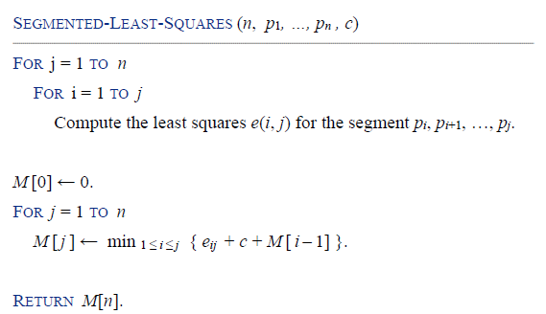
Segmented Least Squares

Slide 7

Segmented Least Squares
The dynamic programming algorithm solves the segmented least squares problem in O(n³) time and O(n²) space.
Bottleneck: computing e(i, j) for O(n²) pairs.
O(n) per pair using formula.
Can be improved to O(n²) time and O(n) space by precomputing various statistics.

Slide 8
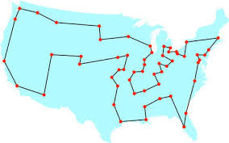
Traveling Salesman Problem
Given n cities and the distances d_{ij} between any two of them, we wish to find the shortest tour going through all cities and back to the starting city. Generally, the TSP is given as a graph G=(V,D) where V={1,2, . . ., n} is the set of cities, and D is the adjacency distance matrix, with ∀i,j∈V, i≠j, d_{ij}>0, the problem is to find the tour with minimal distance weight, that starting at city 1 goes through all n cities and returns to city 1.

Slide 9
Traveling Salesman Problem
The TSP is a well known NP-hard problem.
There are n! feasible solutions. Enumerate them may take O(n!) time.
What is the appropriate subproblem for the TSP?
Suppose we have started at city 1 as required, have visited a few cities, and are now in city j. What information do we need in order to extend this partial tour?
We need to know j, since this will determine which cities are most convenient to visit next.
We also need to know all the cities visited so far, so that we don’t repeat any of them.

Slide 10
Traveling Salesman Problem
For a subset of cities S ⊆ {1,2,...,n} that includes 1, and j∈S, let C(S,j) be the length of the shortest path visiting each node in S exactly once, starting at 1 and ending at j.
How to express C(S,j) in terms of smaller sub-problems.
We need to start at 1 and end at j; what should we pick as the second-to-last city? It has to be some i∈S, so the overall path length is the distance from 1 to i, namely, C(S−{j}, i), plus the length of the final edge, d_{ij}.
We pick the best i, then

Slide 11
Traveling Salesman Problem
There are at most 2^{n}*n subproblems.
Each one takes linear time to solve.
The total time complexity is O(2^{n}*n²).
The sub-problems are ordered by |S|. (Use a queue to extend S))
C({1},1) = 0 for s = 2 to n: for all subsets S ⊆ {1,2,...,n} of size s and containing 1: C(S,1) = for all C(S, j) = return

Slide 12
Traveling Salesman Problem
How to represent the set S?
Usually, we can Represent a set of n elements as an n bit numbers.
Example: (n=5)
S={1}, S={2,4}, S={1,2,3,4,5}
Check if element i is present in set S
S & (1<<i) = 0 if i is not present in S
= 1 otherwise
Find the resulting set when we add i to set S
New set = (S | (1<<i))
Iterating through all the subsets of size <= n
for (i=0; i<(1<<n); i++)

Slide 13
Backtracking
Suppose you have to make a series of decisions, among various choices, where
You don’t have enough information to know what to choose
Each decision leads to a new set of choices
Some sequence of choices (possibly more than one) may be a solution to your problem
Backtracking is a methodical way of trying out various sequences of decisions, until you find one that “works”

Slide 14
Backtracking
Example: Decision making process.
dead end
?
dead end
dead end
?
start
?
?
dead end
dead end
?
success!

Slide 15
Search Tree
A tree is composed of nodes
There are three kinds of nodes:
The (one) root node
Backtracking can be thought of as searching a tree for a particular “goal” leaf node
Internal nodes
Leaf nodes

Slide 16
The backtracking algorithm
Backtracking is really quite simple -- we recursively “explore” each node, as follows:
To “explore” node N:
1. If N is a goal node, return “success”
2. If N is a leaf node, return “failure”
3. For each child C of N,
3.1. Explore C
3.1.1. If C was successful, return “success”
4. Return “failure”

Slide 17
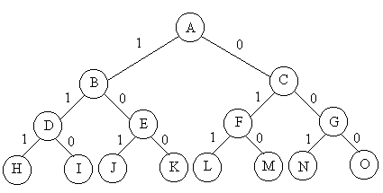
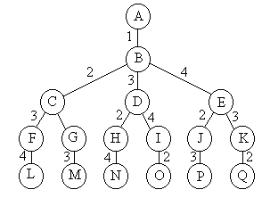
Subset Tree and Permutation Tree
Enumerating all subsets take O(2^{n})
Enumerating all permutations take O(n!)
void backtrack(int t)
{
if (t>n) output(x);
else
for (int i=t;i<=n;i++) {
swap(x[t], x[i]);
if (legal(t)) backtrack(t+1);
swap(x[t], x[i]);
}
}
void backtrack(int t)
{
if (t>n) output(x);
else
for (int i=0;i<=1;i++) {
x[t]=i;
if (legal(t)) backtrack(t+1);
}
}

Slide 18
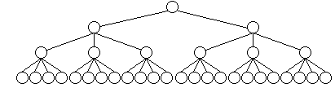
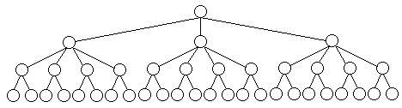
重排原理
对于许多问题而言，在搜索试探时选取x[i]的值顺序是任意的。在其它条件相当的前提下，让可取值最少的x[i]优先。从图中关于同一问题的2棵不同解空间树，可以体会到这种策略的潜力。
(a)
(b)
图(a)中，从第1层剪去1棵子树，则从所有应当考虑的3元组中一次消去12个3元组。对于图(b)，虽然同样从第1层剪去1棵子树，却只从应当考虑的3元组中消去8个3元组。前者的效果明显比后者好。
18

Slide 19
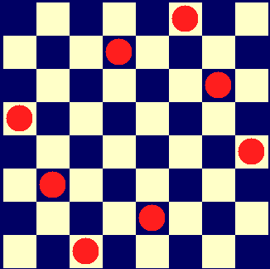
N Queen Problem
In chess, a queen can move as far as she pleases, horizontally, vertically, or diagonally. A chess board has 8 rows and 8 columns. The standard 8 by 8 Queen's problem asks how to place 8 queens on an ordinary chess board so that none of them can hit any other in one move.

Slide 20
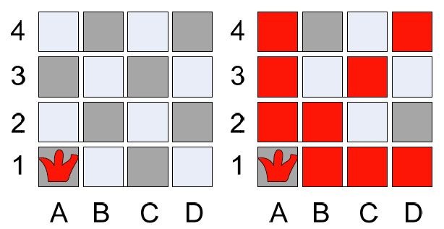
N Queen Problem
Algorithm:
Start with one queen at the first column first row
Continue with second queen from the second column first row
Go up until find a permissible situation
Continue with next queen

Slide 21
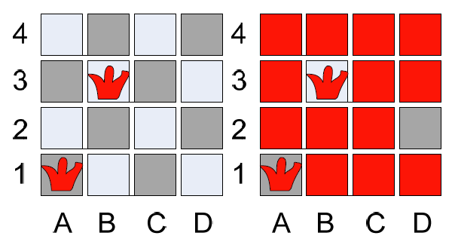
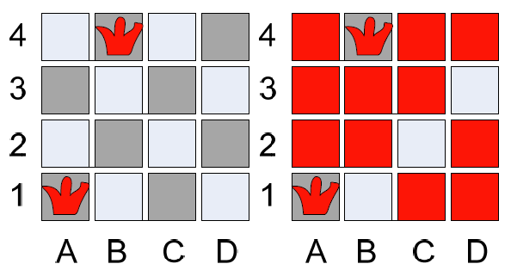
N Queen Problem

Slide 22
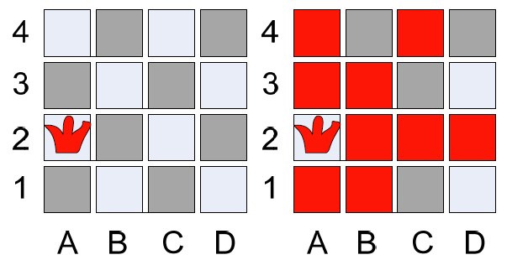
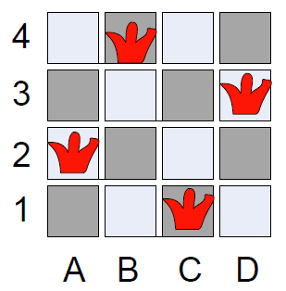
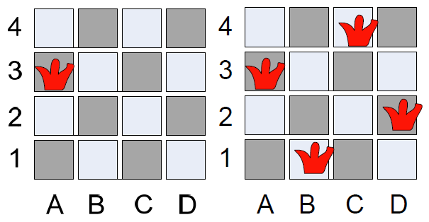
N Queen Problem

Slide 23
N Queen Problem
Different column: x_{i}≠x_{j}
Different diagonal: |i-j|≠|x_{i}-x_{j}|
bool Queen::Place(int k)
{
for (int j=1;j<k;j++)
if ((abs(k-j)==abs(x[j]-x[k]))||(x[j]==x[k])) return false;
return true;
}
void Queen::Backtrack(int t)
{
if (t>n) sum++;
else
for (int i=1;i<=n;i++) {
x[t]=i;
if (Place(t)) Backtrack(t+1);
}
}

Slide 24
Branch-and-bound
The branch-and-bound design strategy is very similar to backtracking in that a state space tree is used to solve a problem.
The differences are that the branch-and-bound method 1) does not limit us to any particular way of traversing the tree, and 2) is used for optimization problems.
A branch-and-bound algorithm computes a number (bound) at a node to determine whether the node is promising.

Slide 25
Branch-and-bound
The number is a bound on the value of the solution that could be obtained by expanding beyond the node.
If that bound is no better than the value of the best solution found so far, the node is nonpromising. Otherwise, it is promising.
Besides using the bound to determine whether a node is promising, we can compare the bounds of promising nodes and visit the children of the one with the best bound.
This approach is called best-first search with branch-and-bound pruning.

Slide 26
Branch-and-bound
An enhancement of backtracking
Applicable to optimization problems
Uses a bound for the value of the objective function for each node (partial solution) so as to:
guide the search through state-space
rule out certain branches as “unpromising”
Many Branch-and-bound methods are adopted using the Depth-First Search (DFS) manner, since it generally consumes little memories.

Slide 27
Breadth-first Search
The Branch-and-bound can also be applied within the Breadth-First Search (BFS) framework.
We can implement the BFS using a queue.
All child nodes are placed in the queue for later processing if they are promising.
Consider the minimization problems.
Calculate the value for each node that represents the minimum possible value if we pick that node.
If the minimum possible value is greater than the global best value, don’t expand the branch.

Slide 28
Best-first Search
The breadth-first search strategy has no advantage over a depth-first search (backtracking).
However, we can improve our search by using our bound to do more than just determine whether a node is promising.
Best-first search expands the node with the best bounds next.
How would you implement a best-first search?
Depth-first is a stack
Breadth-first is a queue
Best-first is a ???

Slide 29
Enumeration in a search tree
Each node is a partial solution, i.e. a part of the solution space
root node
Level 0
child nodes
Level 1
...
child nodes
Level 2
...

Slide 30
Bounding
A bound on a node is a guarantee that any solution obtained from expanding the node will be:
Greater than some number (lower bound)
Or less than some number (upper bound)
If we are looking for a maximal optimal (knapsack problem), then we need an upper bound.
If we are looking for a minimal optimal (traveling salesman problem), then we need a lower bound.

Slide 31
Bounding
We prune (via bounding) when:
(nodeBound >= currentBestSolutionCost) for minimization problem
(nodeBound <= currentBestSolutionCost) for maximization problem
We want to find a globally good solution quickly.
We want to find a good bound for each node.
Initially, a global solution can be obtained by a greedy or an efficient heuristic.
A bound can be obtained by relaxing some constraints of the subproblem related to the node.

Slide 32
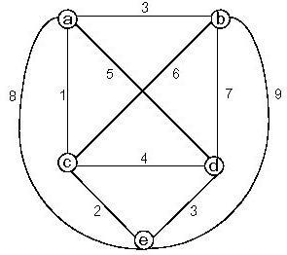
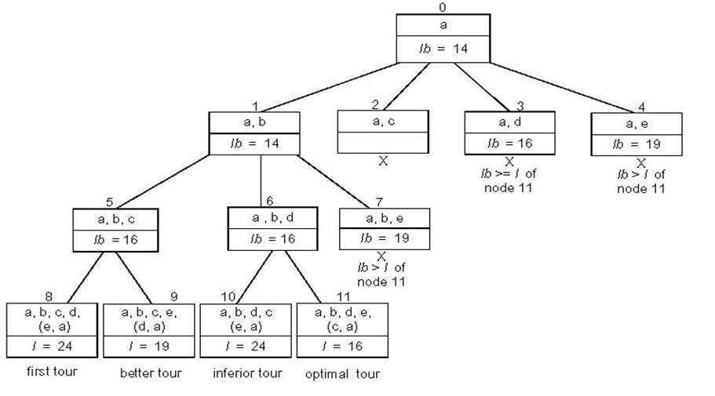
Traveling Salesman Problem
Generate permutations

Slide 33

TSP Bound
Can apply branch & bound if we come up with a reasonable lower bound on tour lengths.
Simple lower bound = finding smallest element in the intercity distance matrix D and multiplying it by number of cities n
Another bound:
1-tree bound: a tour consists of a special spanning tree (namely a path) on the remaining N-1 nodes plus two edges connecting node 1 to this spanning tree.

Slide 34
0-1 Knapsack Problem
Generate subsets
Fractional knapsack bound

Slide 35
Summary: Branch-and-bound
If an optimal solution is found to a subproblem, it is a feasible solution to the full problem, but not necessarily globally optimal.
Since it is feasible, it can be used to prune the rest of the tree.
The search proceeds until all nodes have been solved or pruned, or until some specified threshold is meet between the best solution found and the lower bounds on all unsolved subproblems.

Slide 36
Homework
Sicily 1121, 1148, 1527, 1342, 1345. Select one problem and write a report.
Submit to ftp://smie2.sysu.edu.cn with account and password “student0002”.
Deadline: Nov 15.
Sicily: SMIE12级-算法设计 / Exercise 4

Slide 37

Thank you!

